Slide 1
Unit -2

Slide 2
Unit -2 Public Speaking Skills
2.1 Public speaking : what and why
2.2 overcoming of fear
2.3 . Techniques for effective speaking skill

Slide 3

2.1 Public speaking: what and why

Slide 4
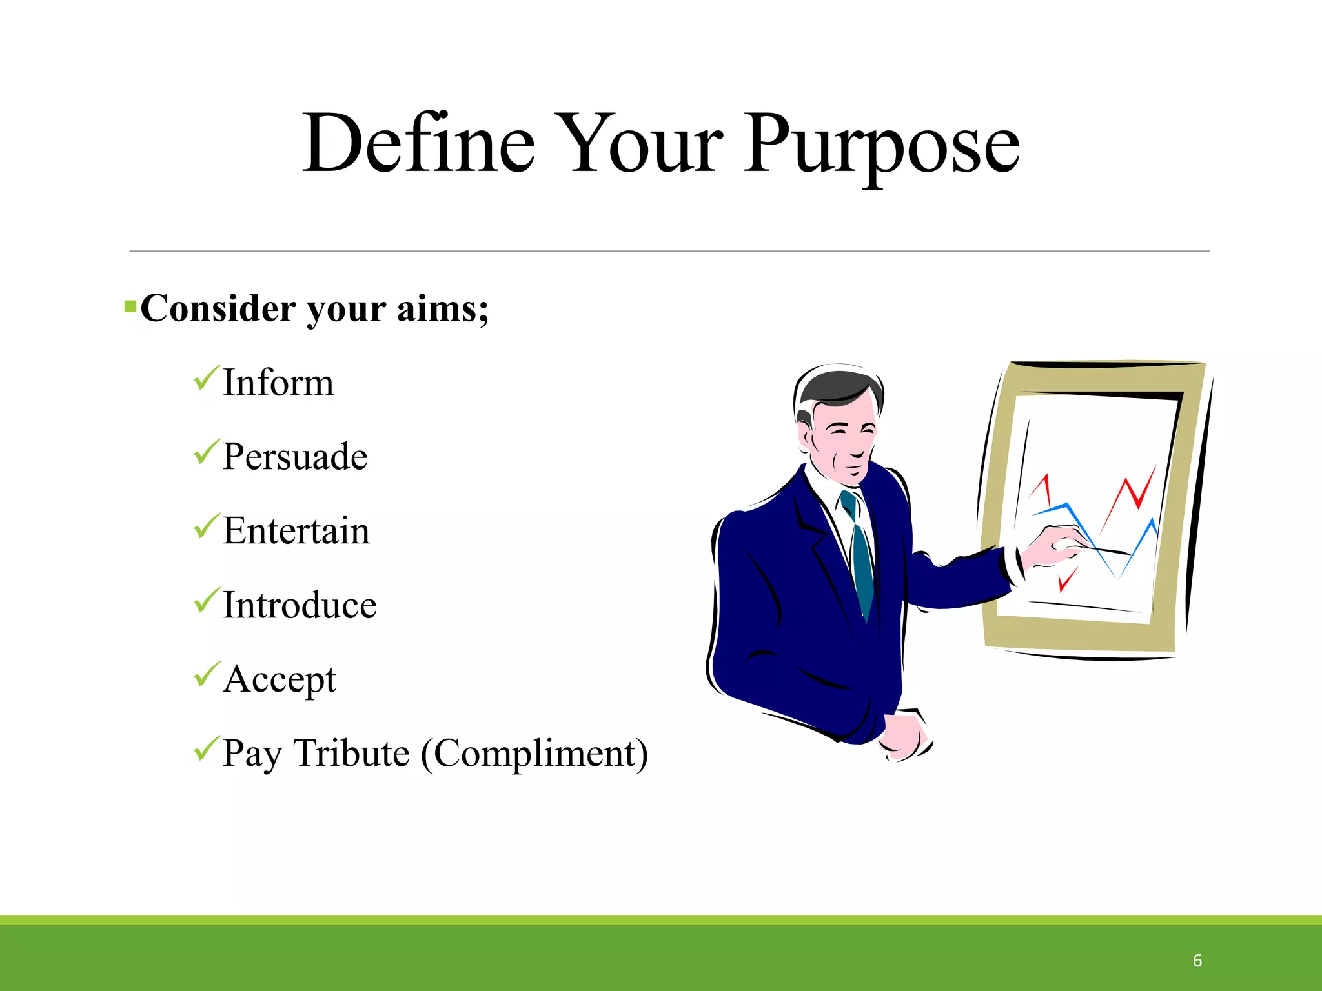

Slide 5

Introduction
Public speaking is the process of speaking to a group of people in a structured, deliberate manner intended to inform, influence, or entertain the listeners.
Public speaking have several components that embrace such things as motivational speaking, leadership/personal development, business, customer service, large group communication, and mass communication.

Slide 6
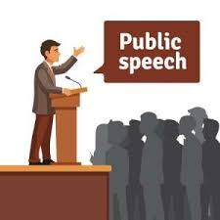
WHERE CAN I USE ??
It May be any of the following:
Seminar in Schools and Colleges
Chief guest's Speech in any function
Presentation in Office
Thanks giving in any function
Motivational Speech as a Leader
Politician Vote Campaign

Slide 7
BENEFITS !!!
Benefits Improve Self Confidence.
Make yourself more comfortable around other people.
Effectively get your message across.
Make a difference in your Life, Business, Career and Community.
Demonstrate your Knowledge.
Create your own supporters.
Fine-tune your verbal and Non-verbal communication skills.

Slide 8

BARRIERS
There are Multiple Barriers that can refrain the user from delivering an excellent Public Speaking Such as
Stage Fear
Lack of knowledge about audience
Lack of knowledge about Topic to be delivered
Improper dress code
Improper Time Management
Improper Vocal behavior Inadequate Audio - Visual aids support

Slide 9
TYPES...
There are 3 Important types of Public Speaking:
1Informative: When a person gives a speech before an audience to impart information on a particular topic or issue, it said to be an informative speech.
E.g. Business presentations, seminars in colleges, class presentations in schools are some examples of informative speeches
2 Persuasive : Persuasive speeches are those where one tries to persuade or convince a group of people. These speeches aim to influence and change the opinions of the audience.
Persuasive speeches are most commonly used by sales and marketing people to attract the interest of potential clients in their products

Slide 10
3Entertaining : Entertaining Speeches are those where one tries to commemorate ог humor the listeners. The Speaker make them happy through Jokes and Short Stories.Standup comedy shows are examples of Entertaining Public Speech

Slide 11
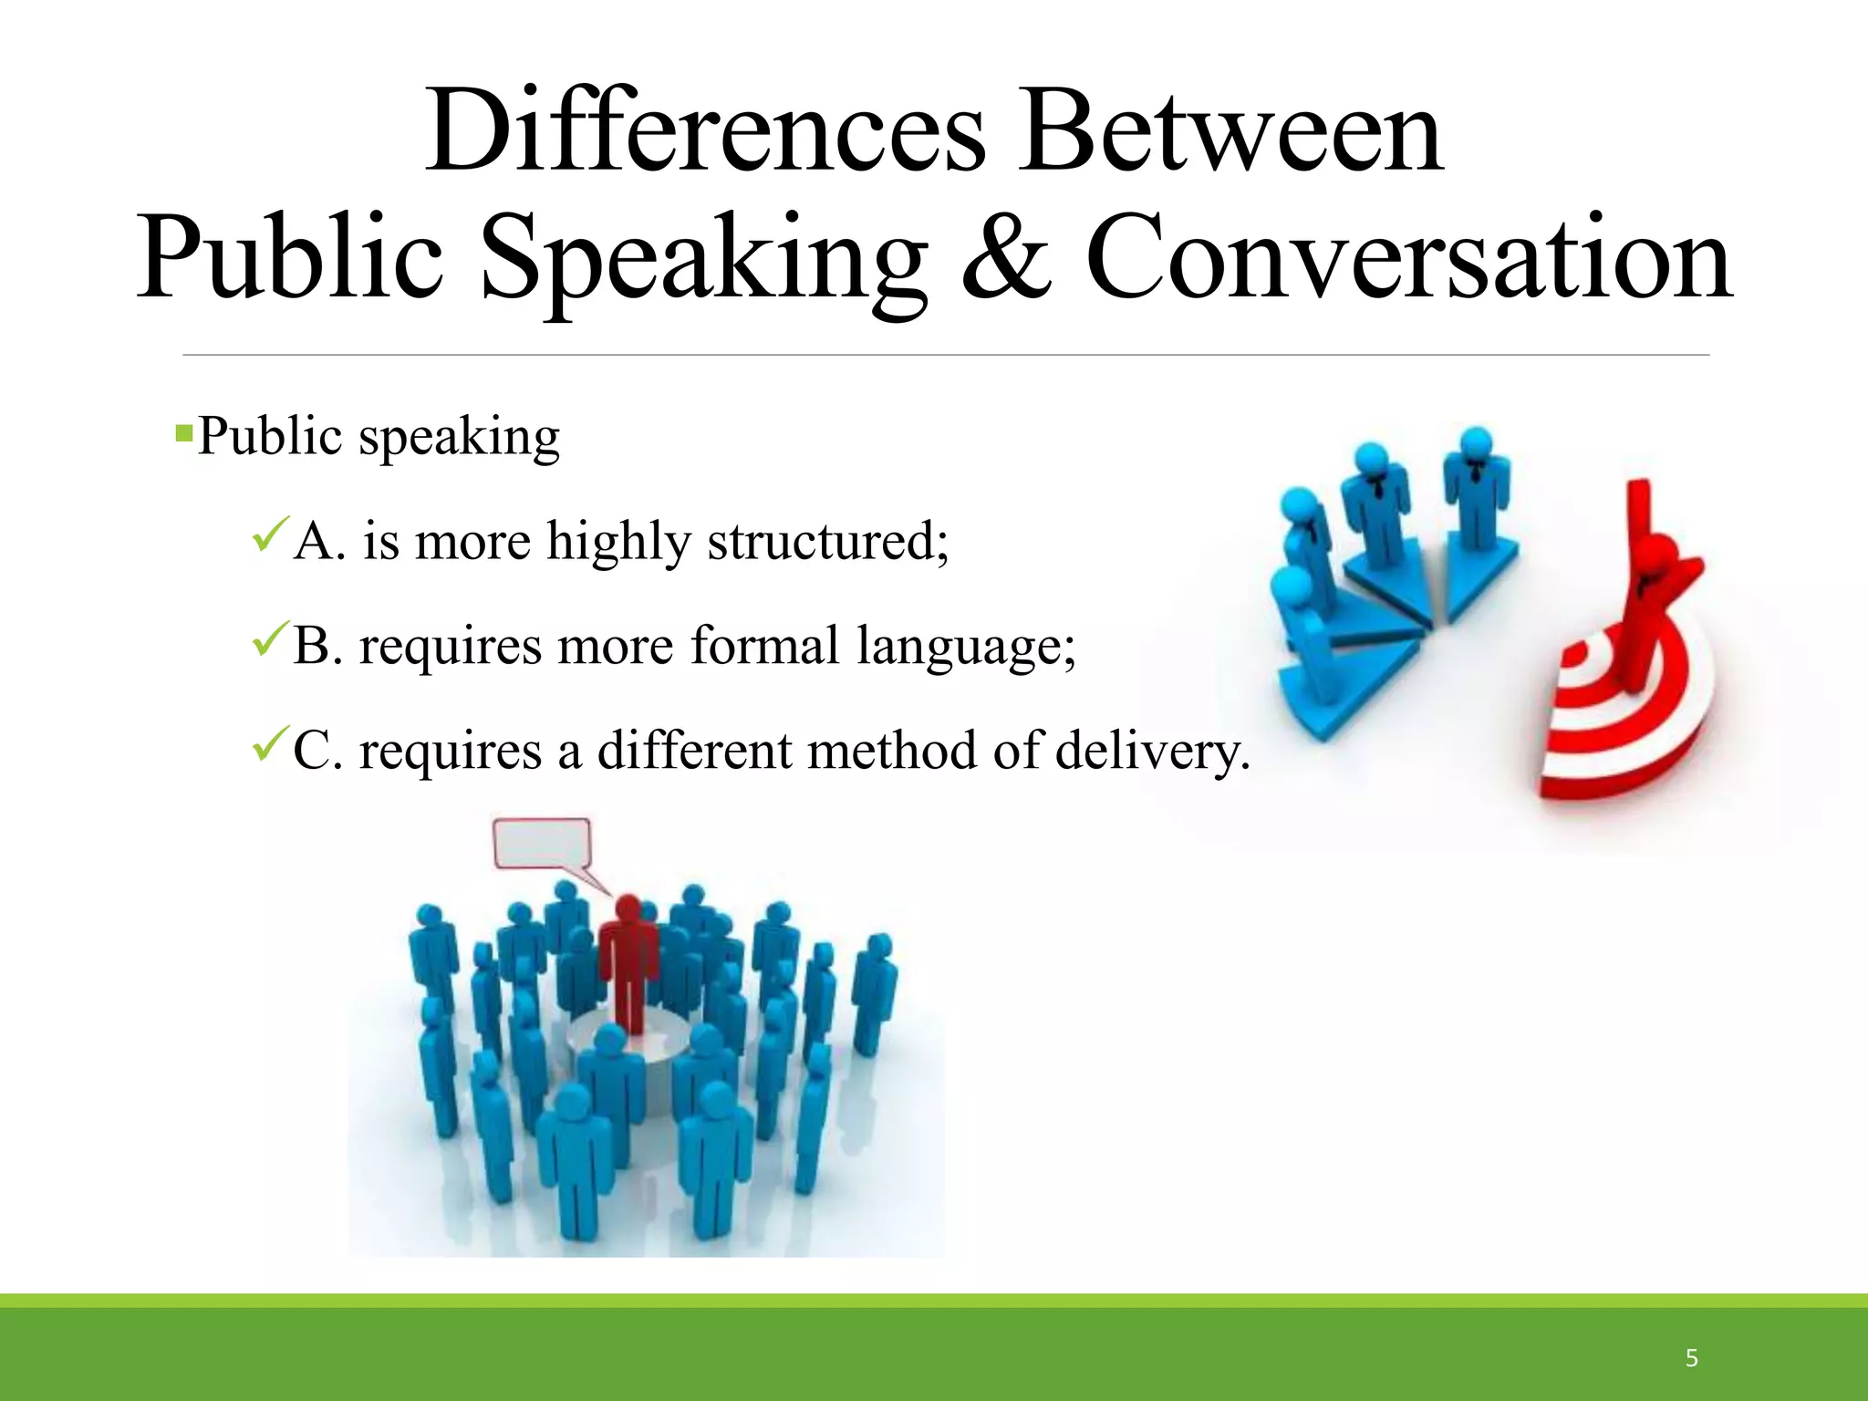

Slide 12
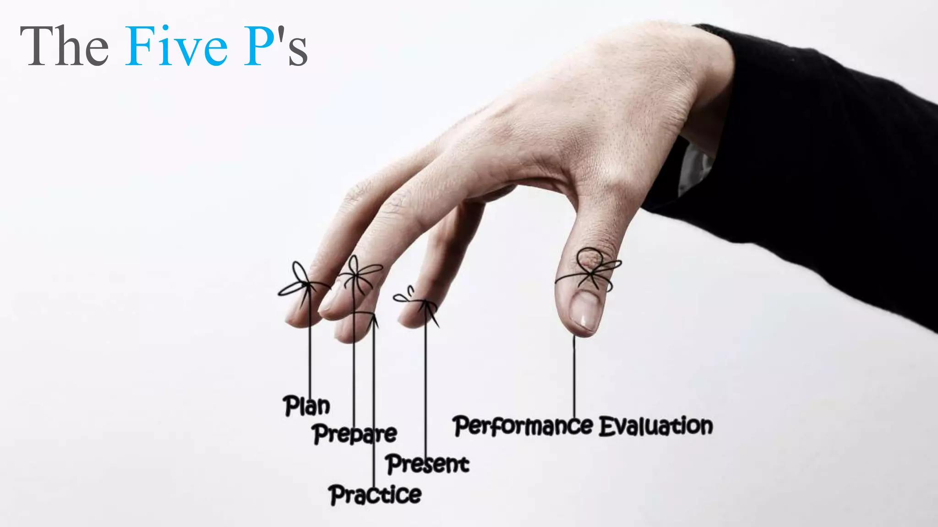

Slide 13

Planning: This involves thoroughly preparing your speech or presentation. Understand your audience, define your objectives, research your topic, and organize your content logically. Effective planning also includes rehearsing your speech multiple times.

Slide 14




Slide 15


Slide 16
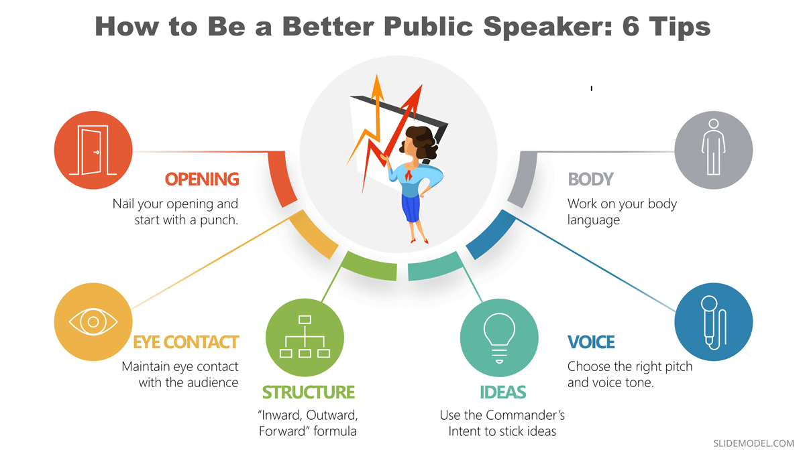
Preparation: Beyond planning, this P focuses on the details. Create visual aids, handouts, or slides if needed. Ensure all your materials are ready and functioning correctly. Prepare for potential questions or issues that may arise.

Slide 17



Practice: Rehearse your speech as much as possible. Practice in front of a mirror, record yourself, or present to a friend or family member. The more you practice, the more confident and polished you'll become. This also helps in managing time and refining your delivery.

Slide 18
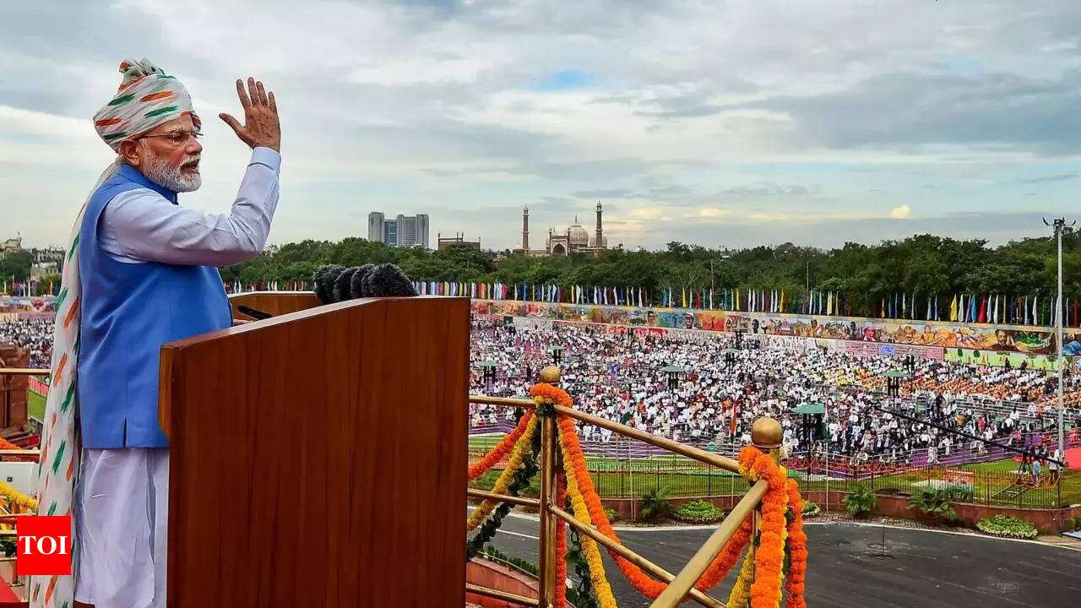
Presentation: This refers to the actual delivery of your speech. Pay attention to your body language, eye contact, and vocal variety. Engage with your audience, use appropriate gestures, and maintain a confident posture. Ensure your message is clear and impactful.

Slide 19
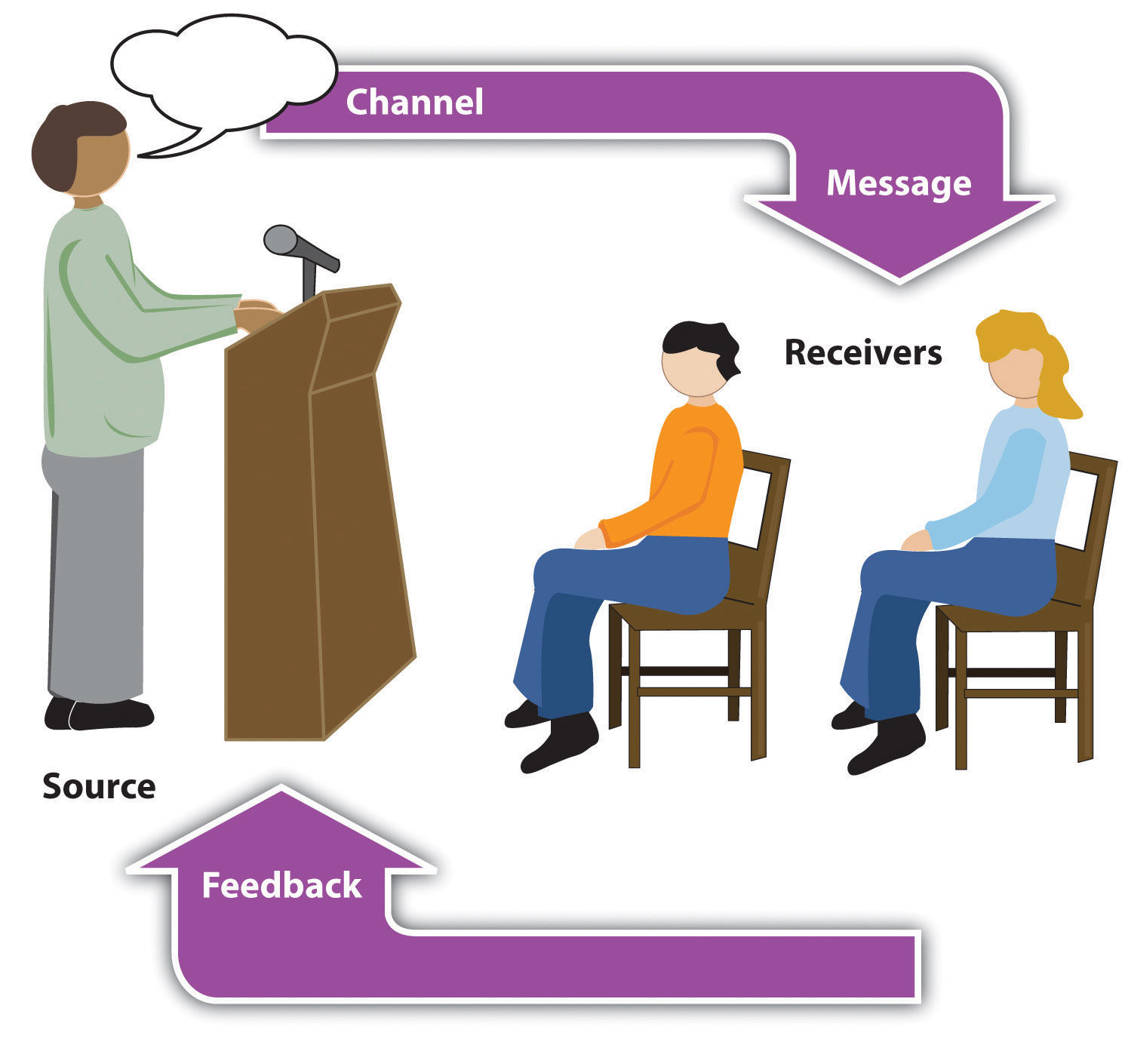
Performance: Consider your speech as a performance. Focus on captivating your audience from beginning to end. Be enthusiastic, dynamic, and authentic. Handle nerves by taking deep breaths and staying focused on your message and audience. After your presentation, seek feedback to improve for future speeches.

Slide 20
1.2 Significance of Public Speaking
Public speaking is a vital skill with numerous benefits and significance in various aspects of personal and professional life:
2.2.1Communication Skills: Public speaking enhances overall communication abilities.
It involves organizing thoughts, articulating ideas clearly, and effectively engaging with listeners.
These skills are transferable to everyday interactions and professional communication.

Slide 21
When you write a speech, you have to think carefully about the best framework, persuasive strategy, and diction to communicate your message to the audience. This type of thinking can help you improve your communication skills in other areas of your life
Personal relationships, social interactions and work situations require you to communicate ideas to other people. Public speaking focuses on communicating ideas. You can learn to calmly take up an opposing view, to present your ideas in an organized and coherent manner, and to defend your views to others.

Slide 22

2. Building Confidence:
Regular practice of public speaking boosts self-esteem and confidence. Overcoming the fear of speaking in front of an audience helps individuals become more self-assured in other areas of their lives.

Slide 23

3. Critical thinking :
Critical thinking improves public speaking skills by enhancing your ability to organize thoughts, communicate effectively, understand your audience, use evidence, handle questions, persuade, solve problems, boost confidence, and adapt to unexpected situations.
It makes your speeches more clear, engaging, and impactful

Slide 24
4.Career advancement
It indicate creativity, critical thinking skills, leadership abilities, and professionalism, qualities which are very valuable for the job market.
Speaking at events and conferences is a good way of building credibility.
You'll learn to speak up in meetings, to promote your ideas, and to present yourself as a professional. Speaking skills can also help you excel in job interviews.
. All sorts of new business and speaking opportunities will open up for you.

Slide 25

5. Leadership: Leaders often need to inspire, motivate, and influence others. Public speaking skills enable leaders to communicate their vision, and create a positive impact on their audience

Slide 26
6. Personal Development: Public speaking fosters personal growth.
It challenges individuals to step out of their comfort zones, develop critical thinking, and become more adaptable.
It also enhances listening skills and empathy by understanding audience reactions and feedback.

Slide 27
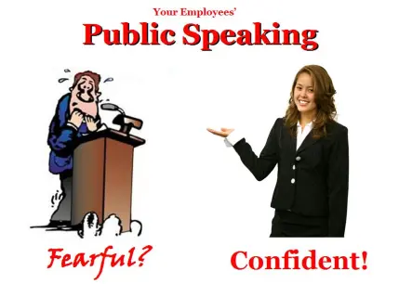

Slide 28

2.2 Overcoming Stage fear

Slide 29
WHAT IS STAGE FEAR?
Stage fright is the anxiety, fear, or persistent phobia that may be aroused in an individual by the requirement to perform in front of an audience, whether actually or potentially.

Slide 30
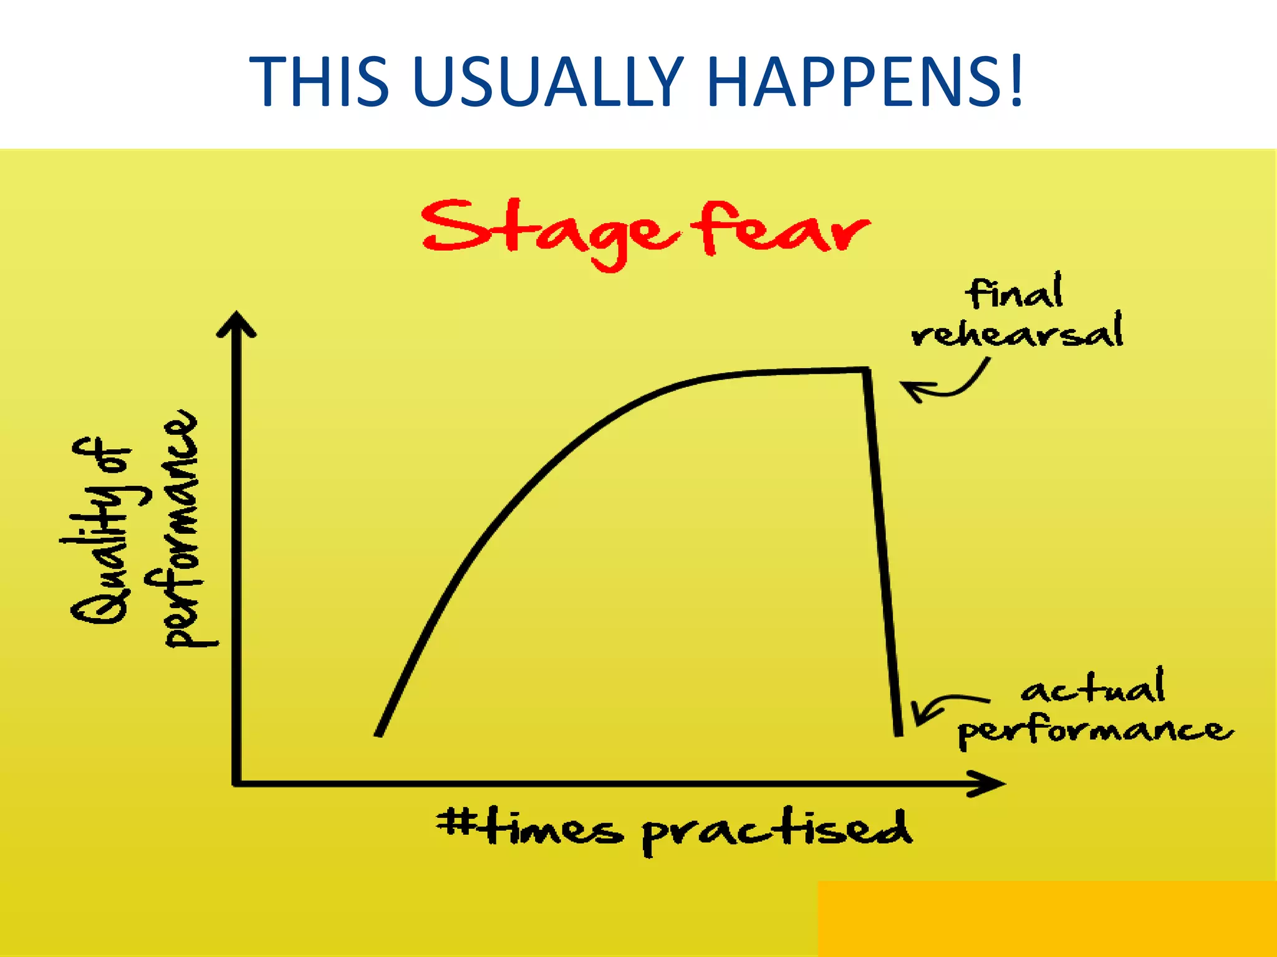

Slide 31
Why do we get stage fright?
The body is flooded with energy (adrenaline) because we sense an emergency situation.
We don't like to be judged.
We don't think our ideas are worth listening to, we don't think we can express our ideas well, or we fear the audience won't like us while we are speaking.
We don't feel prepared.
Negative past experiences.

Slide 32
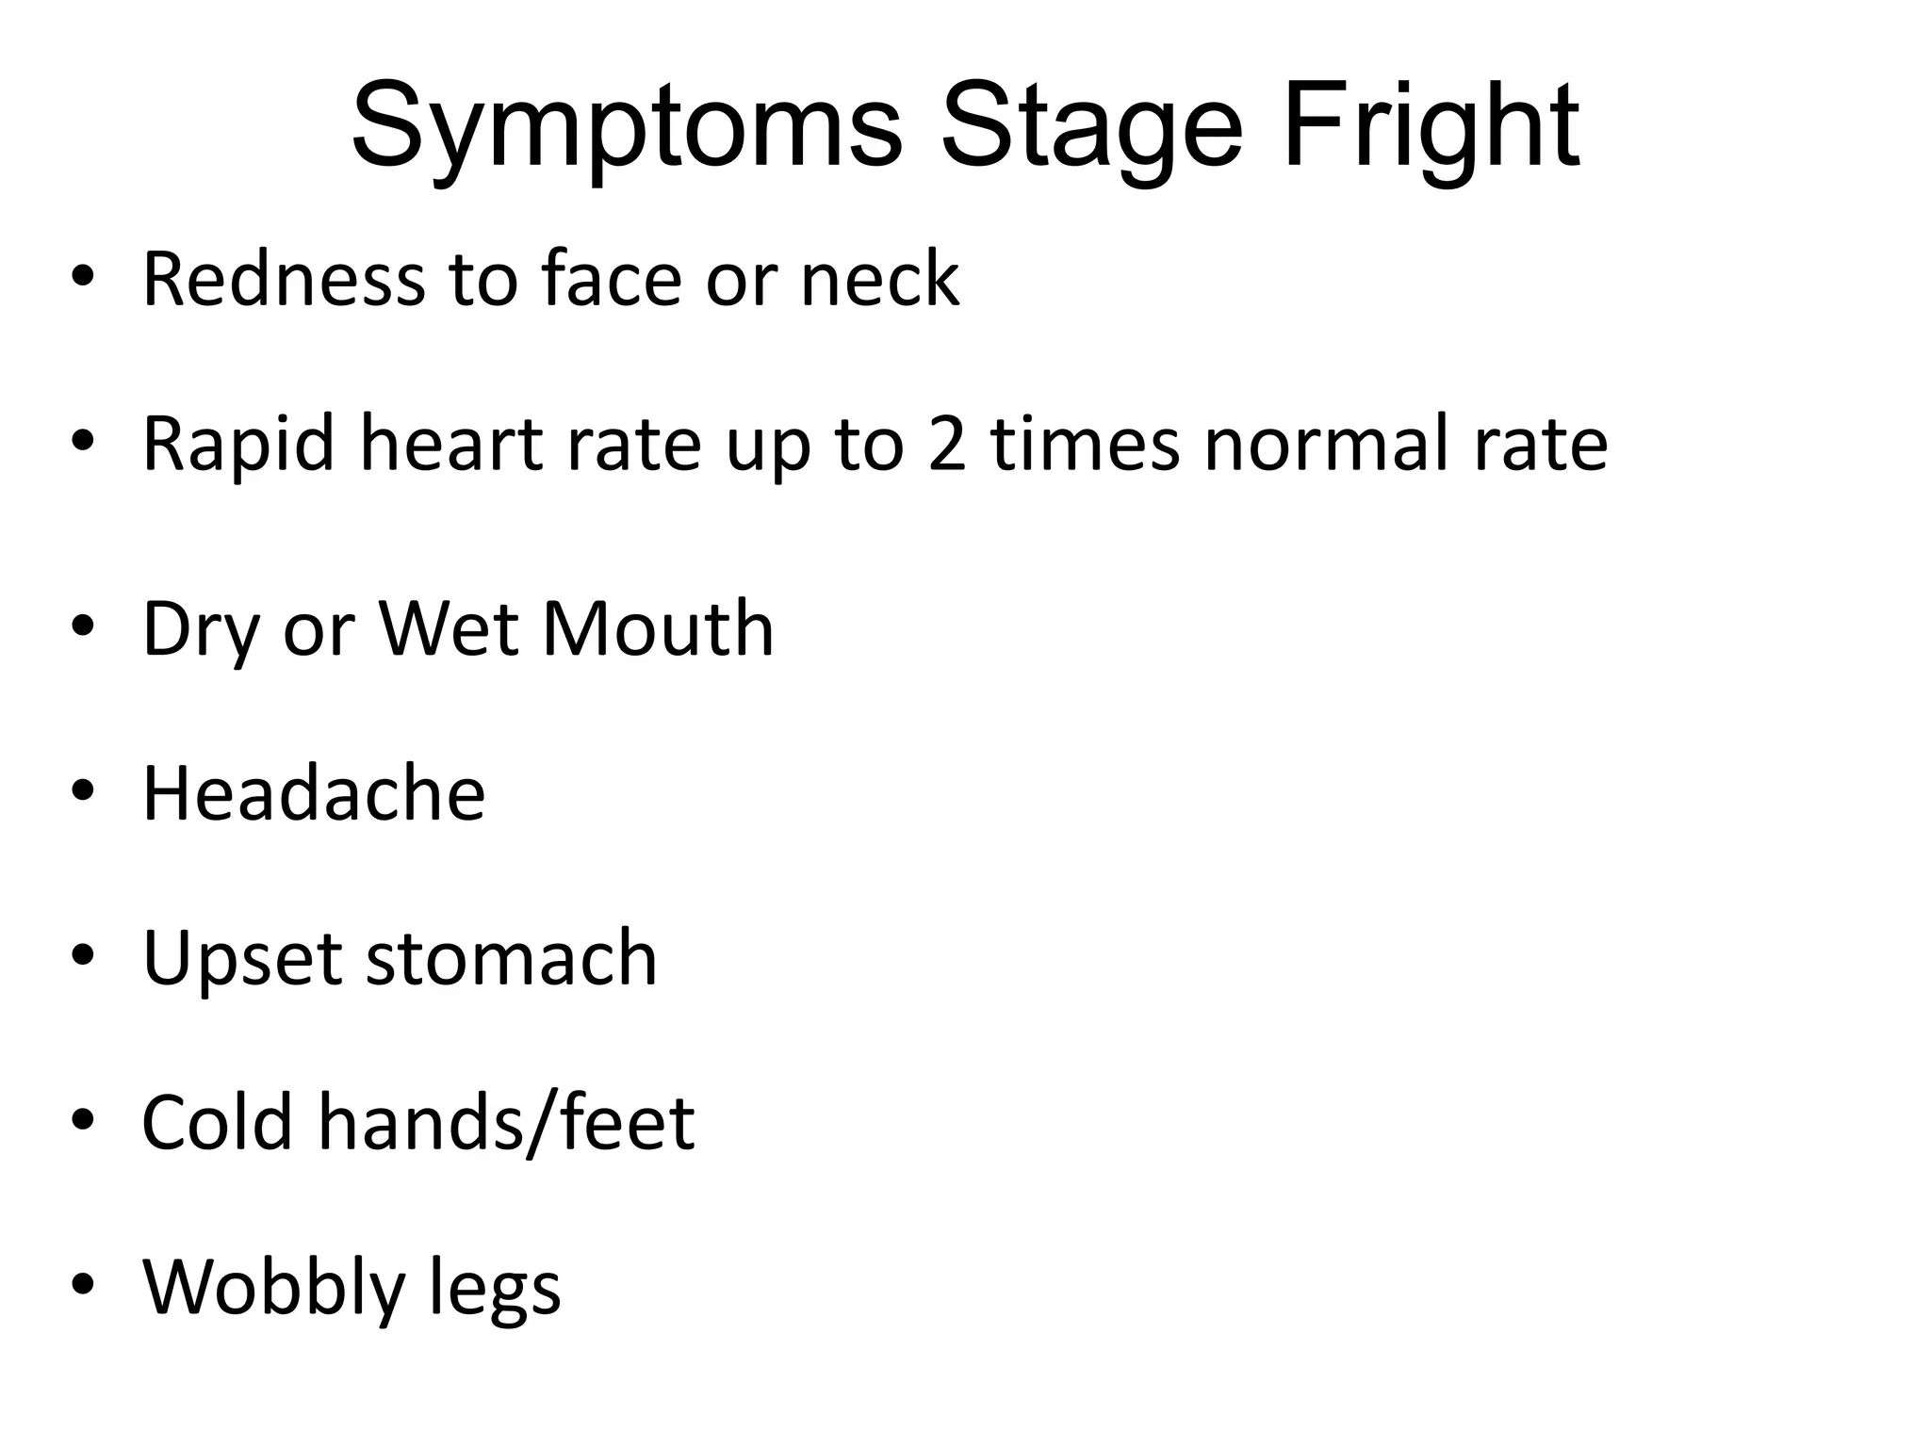
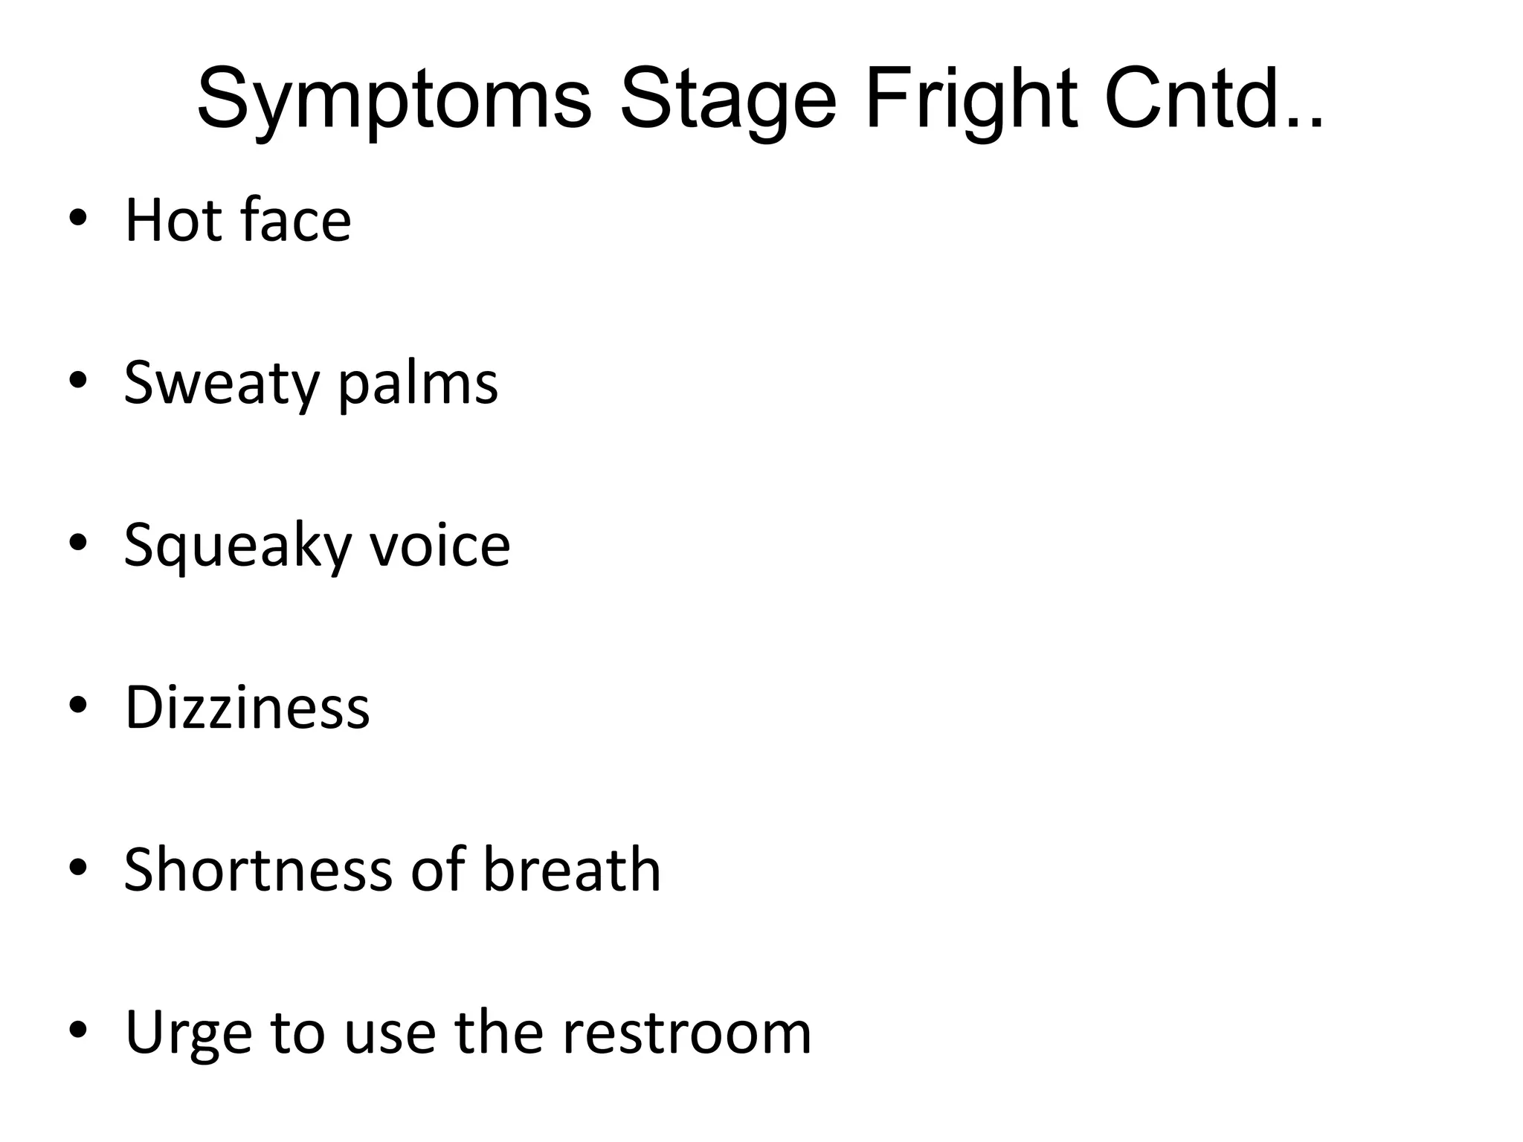

Slide 33
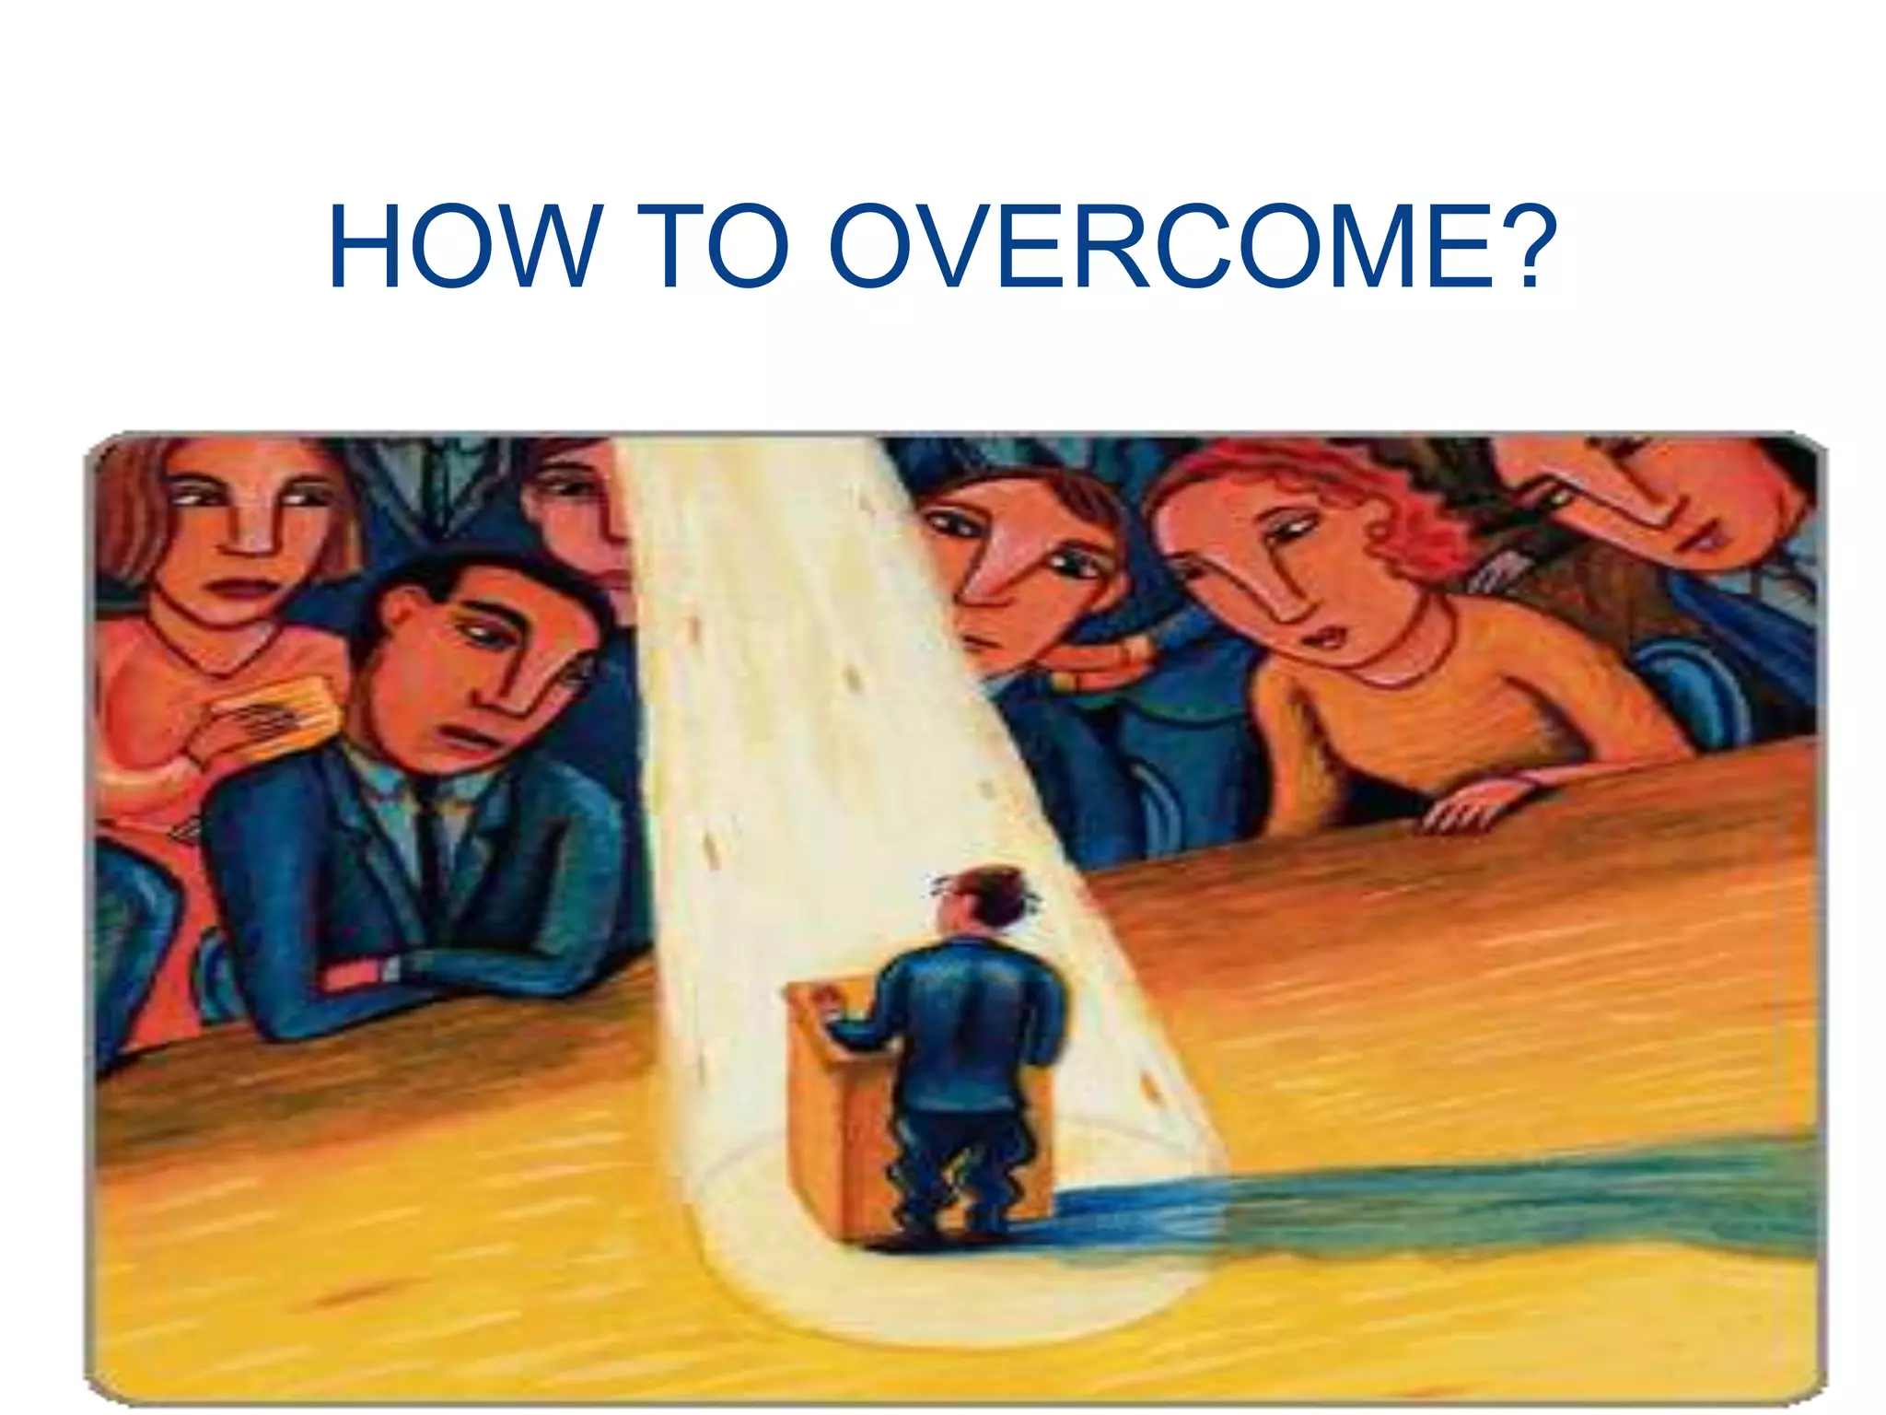

Slide 34
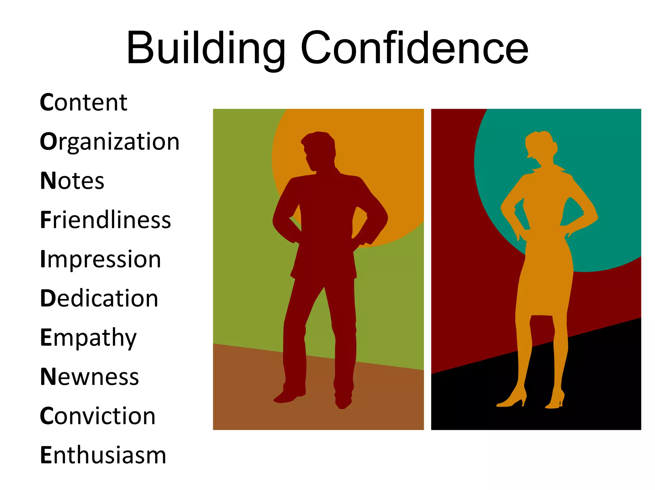

Slide 35
Know the room - become familiar with the place in which you will speak.
Arrive early and walk around the room including the speaking area.
Stand at the lectern, speak into the microphone.
Walk around where the audience will be seated.
Walk from where you will be seated to the place where you will be speaking.
Know the Audience - If possible, greet some of the audience as they arrive and chat with them.
It is easier to speak to a group of friends than to a group of strangers.

Slide 36
Know Your Material - If you are not familiar with your material or are uncomfortable with it, your nervousness will increase. Practice your speech or presentation and revise it until you can present it with ease.
FIRST Learn How to Relax - You can ease tension by doing exercises. Sit comfortable with your back straight. Breathe in slowly, hold your breath for 4 to 5 seconds, then slowly exhale. To relax your facial muscles, open your mouth and eyes wide, then close them tightly.

Slide 37
Visualize Yourself Speaking - Imagine yourself walking confidently to the lectern as the audience applauds. Imagine yourself speaking, your voice loud, clear and assured. When you visualize yourself as successful, you will be successful.
Realize People Want You To Succeed - All audiences want speakers to be interesting, stimulating, informative and entertaining. They want you to succeed - not fail. If the fear of public speaking causes you to prepare more, then the fear of speaking serves as it's own best antidote

Slide 38
Don't apologize For Being Nervous - Most of the time your nervousness does not show at all. If you don't say anything about it, nobody will notice.If you mention your nervousness or apologize for any problems you think you have with your speech, you'll only be calling attention to it. Had you remained silent, your listeners may not have noticed at all
Gain Experience - Experience builds confidence, which is the key to effective speaking.
Most beginning speakers find their anxieties decrease after each speech they give

Slide 39
Things you shouldn't do
Read directly from notes,
Except glancing at Reading directly from screen,
except the points
Turn back on audience
Slouch, hands in pocket
No um, ah, you know
No nervous gestures
Give any bad comments about your audience / insult them
Talk too fast
Talk too quietly

Slide 40
Things you should do
Eye contact: starring at people, there'll be a relation/connection of feeling that will arise.
Can glance at notes
Appropriate gestures
Speak about what you are passionate about
Mind your language, tone and body language

Slide 41
Strong opening :
• A story
• A quote
• A question
• An interesting statistic
Strong Closing → depends on your purpose of speaking:
• Tell your audience to do what you want them to do clearly
• Make an appealing expression
Say impressive and motivational words

Slide 42
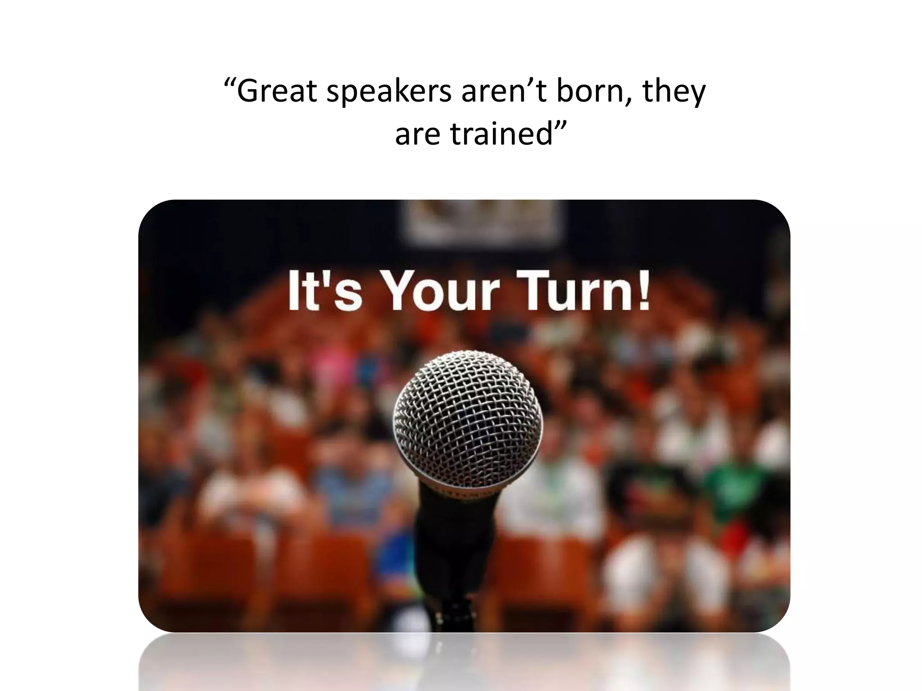

Slide 43
2.3 . Techniques for effective speaking skill
Clarity and conciseness
Confidence
Voice modulation
Body language
Eye contact
Engage the audience
Structure and organization
Visual aids
Practice and feedback

Slide 44
i) Clarity and conciseness
Clarity:
1.Clear message: Convey a well-defined, easy-to-understand message.
2. Simple language: Avoid jargon and complex terminology.
3. Organized structure: Use a logical, coherent structure.
4. Precise tone: Use tone to emphasize key points.
5. Visual aids: Use clear, concise visual aids to support your message.

Slide 45
conciseness
Self-awareness: Understand your strengths, weaknesses, and emotions.
Audience awareness: Know your audience's needs, interests, and level of understanding.
Mindfulness: Stay present and focused on your message and audience.
Authenticity: Be genuine, transparent, and true to yourself.
Emotional intelligence: Recognize and manage your emotions and your audience.

Slide 46
ii) Confidence
Prepare thoroughly: Know your material inside out.
Practice consistently: Rehearse in front of a mirror, record yourself, or speak in front of a small group.
Focus on your message: Concentrate on the value you're providing to your audience.
Use positive self-talk: Encourage yourself with positive affirmations.
Visualize success: Imagine yourself delivering a successful presentation.
Take care of yourself: Get enough sleep, exercise, and eat well to reduce stress and anxiety.

Slide 47
iii)Voice modulation
:1. Pitch: your pitch to convey emotions, such as raising your pitch for excitement or lowering it for seriousness.
2. Tone: Use different tones to convey attitudes, like friendliness, authority, or sarcasm.
3. Volume: Adjust your volume to emphasize points, like speaking louder for importance or softer for intimacy.
4 Pauses: Use strategic pauses for emphasis, drama, or to allow the audience to absorb information.
.5.Articulation: Enunciate clearly to ensure understanding
6. Emphasis: Use emphasis to draw attention to key points or words.
7. Authenticity: Be true

Slide 48
IV) Body language
Posture: Maintain good posture, standing up straight and avoiding slouching.
Eye contact: Engage with your audience through regular eye contact, but avoid staring.
Facial expressions: Use positive facial expressions like smiling, and avoid negative ones like frowning.
Gestures: Use purposeful gestures to emphasize points, but avoid distracting movements.
Hand movements: Use open and confident hand movements, avoiding fidgeting or hiding hands.
6. Relaxation: Relax your body and avoid tension, which can be visible to the audience.

Slide 49
V)Eye contact
Engage with different sections of the audience
Make eye contact with individuals, not just scanning the room
Hold eye contact for 2-3 seconds per person
Vary eye contact to avoid staring or making anyone uncomfortable
Use eye contact to emphasize key points or transitions
6.. Practice eye contact in everyday conversations to build comfort
7. Avoid reading from notes or slides excessively
8. Use eye contact to connect with your message and show passion

Slide 50
vi)Engage the audience
Know your audience: Understand their needs, interests, and level of understanding.
Use storytelling: Share relatable, personal anecdotes or examples to illustrate points..
Make eye contact: Connect with individual audience members.
Vary tone, pitch, and pace: Add emphasis and keep the audience engaged.
Use humor: Appropriately use humor to break the ice and build rapport.
Encourage interaction: Ask for feedback, questions, or discussions.
Use visual aids: Incorporate engaging visuals, props, or demonstrations.
Be authentic and passionate: Show genuine enthusiasm and conviction.

Slide 51
vii) Structure and organization
Create an outline to guide your speech
Use a consistent structure for each main point
Use clear and concise headings and subheadings
Use bullet points or numbered lists when appropriate
Leave time for questions and answer
Clearly convey your message
Engage and persuade your audience
Build credibility and authority
Make a lasting impression- Achieve your speaking goals

Slide 52
viii)Visual aids
Slides (e.g., PowerPoint, Google Slides)
Videos
3. Images (photos, diagrams, charts)
4. Props (objects, models, samples)
5. Handouts (printed materials, flyers)
6. Whiteboard or blackboard
7. Posters or banners
8. Infographics
9. Graphs and charts
10. Interactive tools (polls, quizzes, Q&A sessions)
Best practices for using visual aids:
Keep it simple and clear
2. Use high-quality images and graphics
3. Limit text and focus on key points
4. Use color and contrast effectively
5. Practice with your visual aids
6. Ensure visibility and accessibility
7. Use visual aids to support your message, not distract from it
8. Use

Slide 53
ix)Practice and feedback
Practice:
Rehearse in front of a mirror or record yourself.
Practice in front of small groups or friends.
Join a public speaking group, like Toastmasters.
Take a public speaking course or workshop.
Practice regularly, even if just for a few minutes.
Feedback:
Ask for feedback from others after your speech.
Join a public speaking group that provides constructive feedback.
Use online resources, like video analysis tools.
Record yourself and analyze your performance.
Be open to feedback and use it to improve.

Slide 54


